Slide 1

A year (or 2) in the life of Open Access support: choosing LEAN and continuous improvement
Jackie Proven
Repository & Open Access Services Manager
jep10@st-andrews.ac.uk

Slide 2
Open Access support
“It’s complicated!”
Describing our work often involved drawing complex diagrams of the interaction between policies, infrastructure and people.
It became clear that we needed a way to navigate this complexity that raised awareness, involved more people across the University, and that would help us solve a few problems.

Slide 3
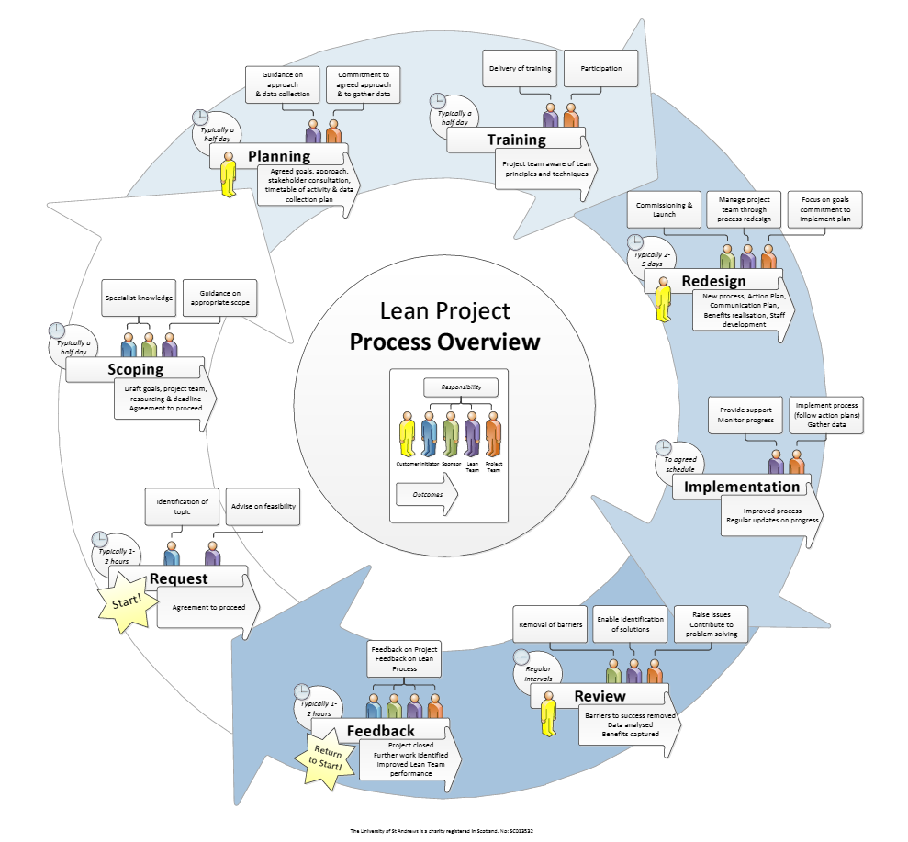
Becoming LEAN
http://prezi.com/jbed7jq1d0ke/?utm_campaign=share&utm_medium=copy&rc=ex0share

Slide 4
Becoming LEAN
Get the right people in the room
Scope, plan and take time to learn
Challenge the status quo
Build lasting relationships
Commit to actions in the long term
Continuous improvement
Respect for people
Notes:
What it’s not – Quick fix, set of tools, cost cutter, performance management

Slide 5
St Andrews OA team
Part of Digital Research, University Library
  4 FTE (incl. 3 fixed-term posts funded externally)
Supporting:
  External funders’ open access mandates and funds
  Selection and management of publisher schemes
  Payment of Article Processing Charges (APCs)
  Copyright, licensing and policy advice
  Deposit of publications in our repository (via Pure)
  Active programme of advocacy and support
  OA Journal hosting service
Working closely with RDM and other initiatives

Slide 6
OA policies
“The University encourages its researchers to provide Open Access to published research outputs ...”
http://www.st-andrews.ac.uk/library/services/researchsupport/openaccess/oapolicy/
  Researchers are free to publish in the venue of their choice
  Preference is for the ‘green’ route
  Also supports ‘gold’ in particular circumstances
Funder policies
  Wellcome Trust… Charities fund
  RCUK… block grant
  EU pilots… Horizon 2020 requirements
  OA for REF!!

Slide 7

REF* OA policy
Post-2014 REF Open Access Policy
Policy applies to journal articles and conference proceedings with an International Standard Serial Number (ISSN)
To be eligible for REF, final peer-reviewed manuscripts must have been deposited in an institutional or subject repository on acceptance for publication
HEFCE understands that not all REF outputs may be able to meet requirements and so limited exceptions will be permitted
*Research Excellence Framework

Slide 8
Challenges
How do we get to know about new publications so that the support and dialogue can begin?
How do authors know where to find help to make informed choices and ensure compliance?
How do we join up research support across the University?
Notes:
The natural dialogue of authors is with their publishers, not their Institutional Repository or Library
Researchers may get support from grants office – how does this relate to our activities?
University strongly encourages OA via local deposit but no mandate

Slide 9
Goals
Open up channels between the researchers’ workflows, OA support workflows, and related support operations across the University
Change the culture and try to integrate this deposit process into the publishing workflow
Provide support and advice for authors to make it (relatively) easy

Slide 10


Building the third Forth bridge
Queensferry Crossing - north cable tower © Copyright M J Richardson and licensed for reuse under this Creative Commons Licence.

Slide 11

Building the third Forth bridge
Queensferry Crossing © Copyright M J Richardson and licensed for reuse under this Creative Commons Licence.
Queensferry Crossing - north cable tower © Copyright M J Richardson and licensed for reuse under this Creative Commons Licence.

Slide 12
LEAN plan
Originally envisaged to cover funder mandates and the process of paying/managing APCs
  Key ‘blocker’ - timely invoice payments
Extended to cover REF OA policy and ‘intervention’ earlier in publication lifecycle
  Key problem - knowing about accepted articles
Driver to be ready for REF OA compliance in 2016
  Key aim - raise awareness (from a fairly low level)

Slide 13
LEAN experience
Energised us and gave focus
Involved (mostly) the right people
Developed communications strategy for open access
  Simple message(s) at key points
  New web pages
  Clear points of contact
Using 2014 and 2015 as a learning experience and be ready for the real onset of compliance in 2016

Slide 14
Scoping our plan
SPECIFIC: ‘Deposit in PURE’ should become part of University research culture by April 2015
MEASURABLE: Baseline deposit statistics in May 2014, to be reviewed in 6 months
ACHIEVABLE: Yes - Has to be to prepare for the next REF
REALISTIC: Incentives to change behaviour are now greater (REF). We have PURE and central support in place
TIMESCALE: April 2015 (to be well prepared for REF)

Slide 15
Project members
Lean facilitator
OA team members
Secretary, School of Chemistry
School Manager, School of Computer Science
Supervisor, Finance (Accounts Payable)
School administrator, Biomedical sciences
Manager, Grants office
Researcher(s)

Slide 16
People in the room
Lean facilitator
OA team members
Secretary, School of Chemistry
School Manager, School of Computer Science
Supervisor, Finance (Accounts Payable)
School administrator, Biomedical sciences
Manager, Grants office
Researcher (update sessions)
Notes:
Additionally we report to senior managers in a final session

Slide 17
Discussion
Would this work in your institution?
What do you want to improve?
Who would you get in the room?

Slide 18
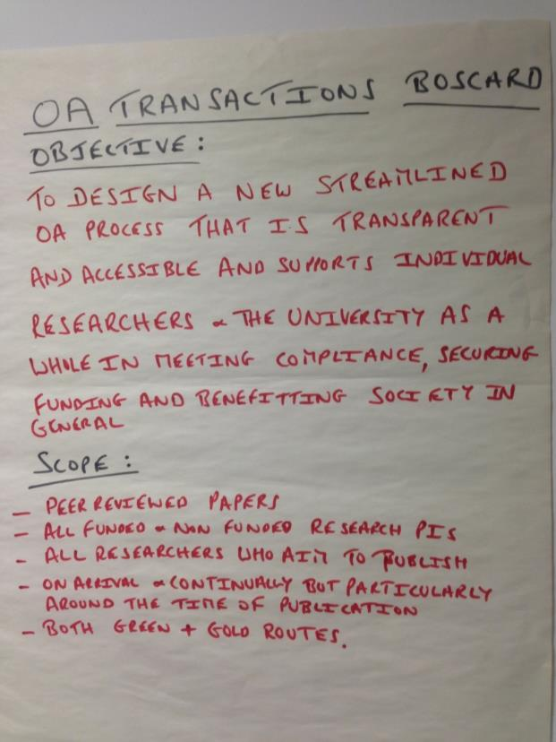
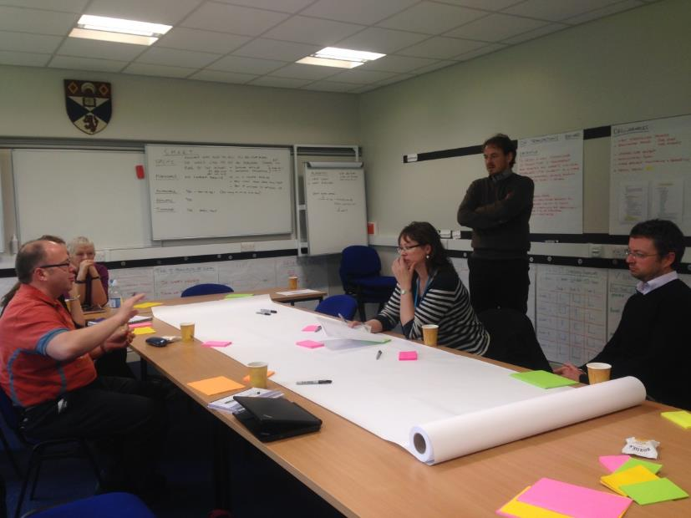

Slide 19
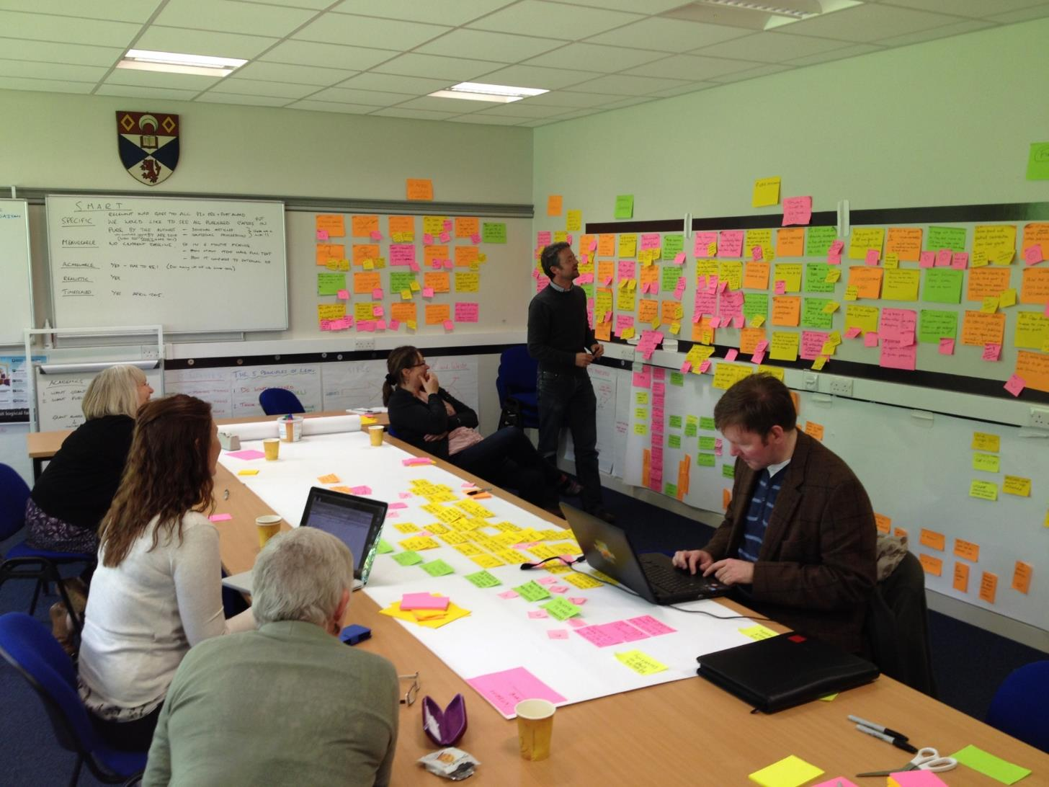

Slide 20
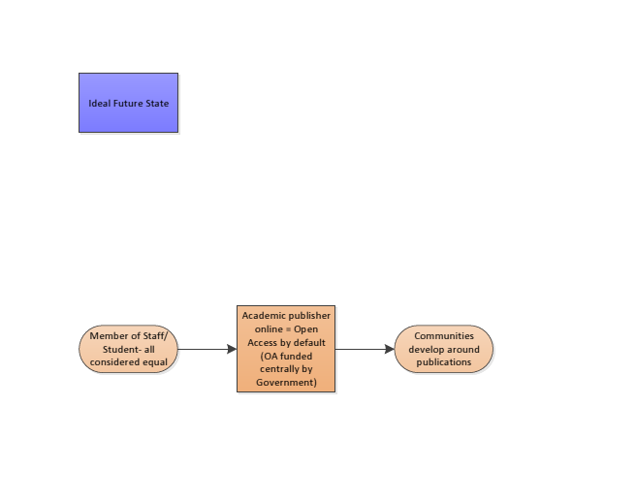
Lean exercise: process mapping
Discovery, networks, sharing…

Slide 21
Lean exercise: process mapping

Slide 22
Notes:
High level view of lifecycle, and where the CRIS currently helps… where else?

Slide 23
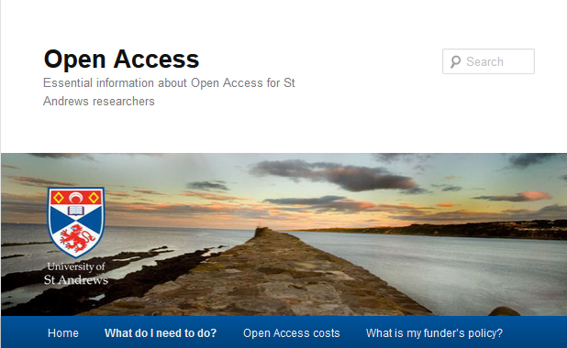
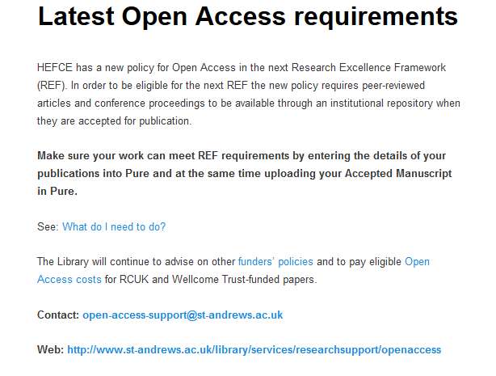
http://openaccess.wp.st-andrews.ac.uk/

Slide 24
#OAGP projects
Joint LOCH Pathfinder OAGP project with University of Edinburgh and Heriot Watt University
http://libraryblogs.is.ed.ac.uk/loch/2014/06/24/welcome-to-the-loch-blog/
http://openaccess.jiscinvolve.org/wp/pathfinder-projects/
Community of practice
History of collaboration
Synergies with LEAN
‘Mini pathfinder’ pilot projects with academic schools to develop efficiencies

Slide 25
‘Mini pathfinders’
Initial meeting with key staff
Have a set of questions and discussion points ready, relevant to their discipline
Ask how they think they can achieve OA compliance
Seed ideas for partnerships and joint working
Listen!

Slide 26
School of Chemistry pathfinder:
Local mediation
Article accepted by publisher
Author receives notification
(Library may receive notification)
Author notifies School office
Forward notification email
Send accepted manuscript
School office enters article in PURE
Create new metadata record
Upload full text accepted manuscript
Library validation
Library enhances metadata
Library checks version, applies embargoes
Follow-up and advice
Library contacts authors/office for additional information and/or correct versions
Additional actions
Library advises authors on additional funder requirements
Library advises on funding for immediate OA
Link grants / data
Advice on data management
Gold OA required?
Notes:
People in the chain know about it and can step in to provide support
Data can be revisited, with revalidation triggers

Slide 27
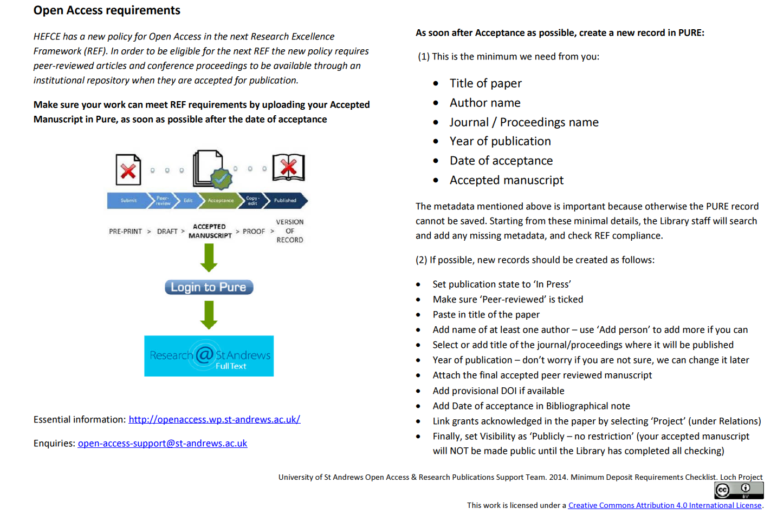
School of Computer Science:
Minimum metadata checklist

Slide 28
Results
Requests for advocacy sessions
Increase in enquiries
Closer contact with School administrators
Upskilling in fine detail of REF OA policy
Understanding disciplinary needs and approaches
Increase in content and compliance
Agreed APC processes

Slide 29
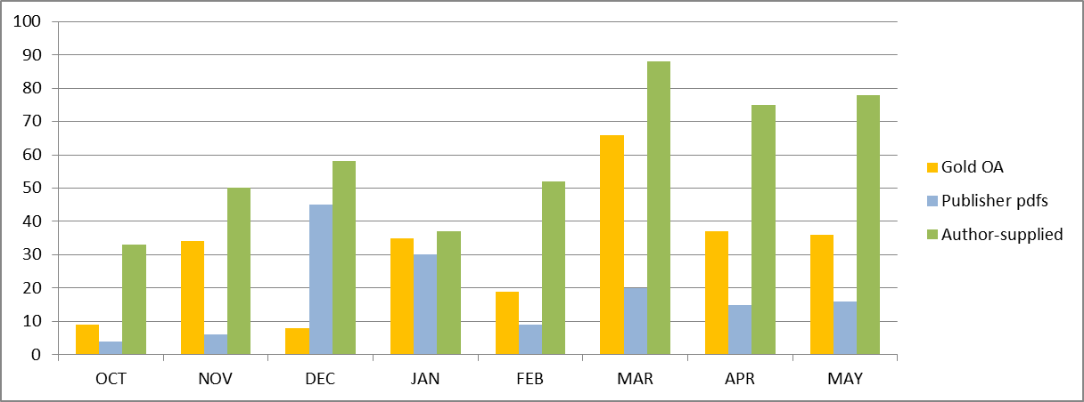
Changing profile of deposits
Pure deposits validated 2014/15
Notes:
Gradual move to author-driven deposits

Slide 30
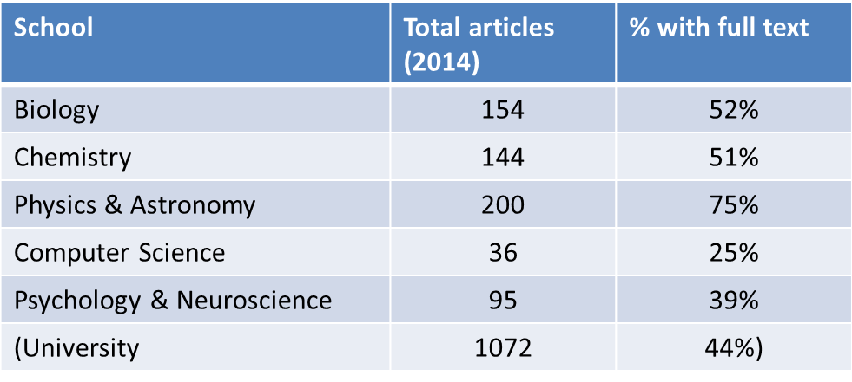
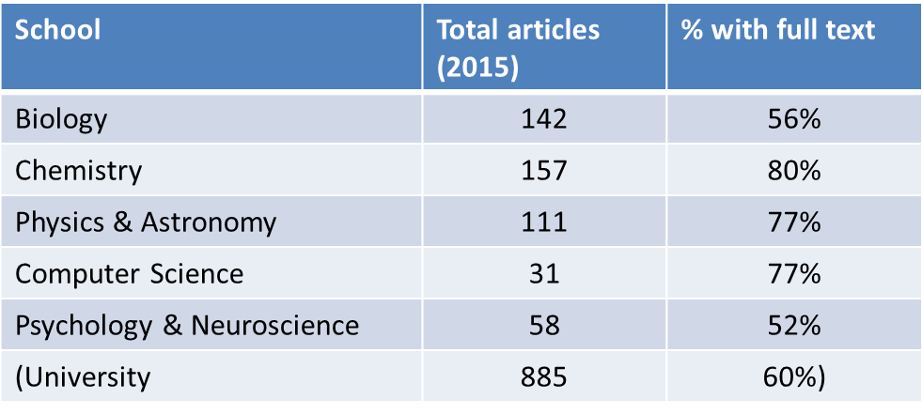
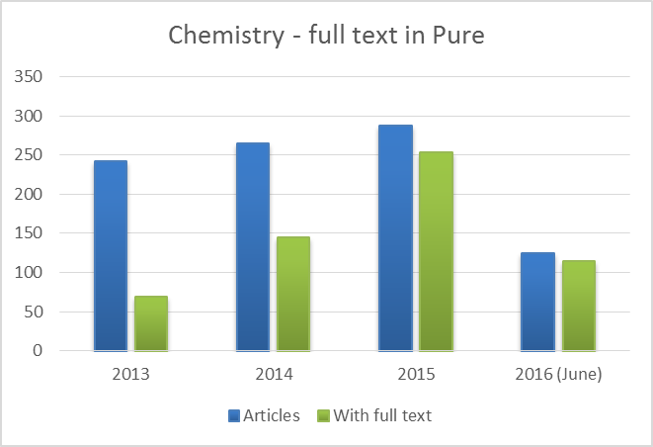
Changing culture through pathfinder
88%
55%
91%
29%
Notes:
Support in the right places leading to change of attitudes – ‘it’s actually not that hard’

Slide 31
Continuous improvement…
  Tailoring training sessions
  Managing queries [Shared experience with Glasgow, E2EOA]
  Locally mediated deposit and new OA ‘champions’
  Guides on deposit and FAQ on REF OA policy
  Learning what motivates authors to buy in to OA
  Reporting good stats on usage
  Revising APC payment processes… [APC survey, UCL]
  Reviewing our workflows… [Insights from Lancaster, E2EOA]

Slide 32
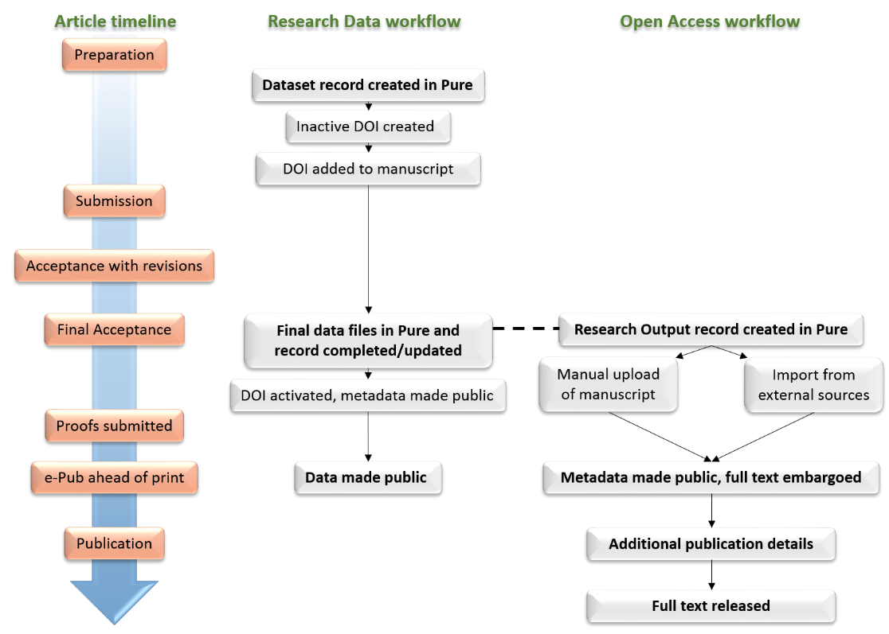
New workflows to enable Open Research

Slide 33
Reflections…
  Not everyone will be on board
  Your list of actions might be VERY long
  Not everything goes to plan
  Be prepared to revise and revisit your solutions
  PEOPLE are absolutely key

Slide 34
References
LEAN case study: http://hdl.handle.net/10023/6430
Open Access ‘essentials’ web pages
http://openaccess.wp.st-andrews.ac.uk/
Library OA support web pages
http://www.st-andrews.ac.uk/library/services/researchsupport/openaccess/
LEAN in University of St Andrews
http://www.st-andrews.ac.uk/lean/
http://www.st-andrews.ac.uk/lean/method/
Email: open-access-support@st-andrews.ac.uk

Slide 35
Over to you…
What are the key stages of your OA workflow?
Is there a shared understanding of this workflow in your team / across your institution?
Can you visualize your ‘ideal state’?

