Slide 1

Lessons in OA Compliance for HE (LOCH)
University of St Andrews
Case study
Janet Aucock
Head of Repository Services
ja@st-andrews.ac.uk
FOSTER Open Access: A good practice exchange, London, 19 March 2015

Slide 2


Slide 3
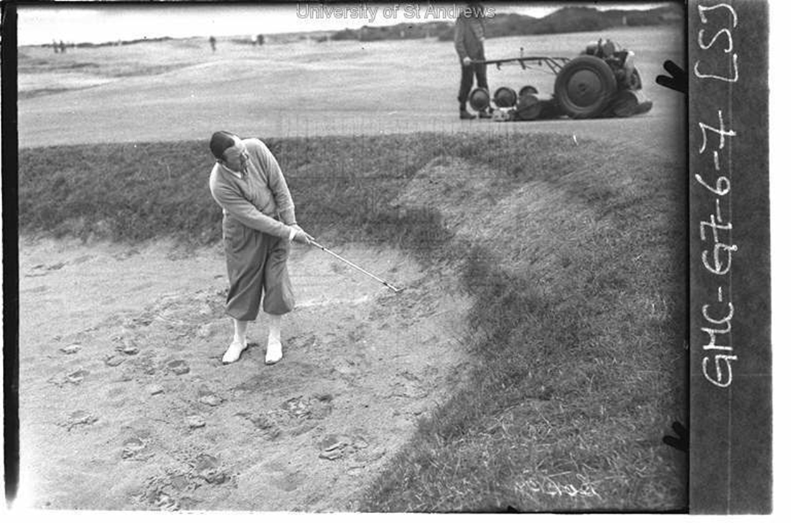

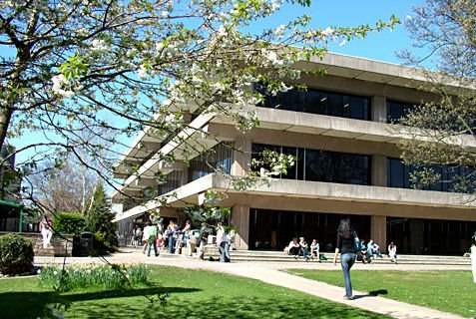


Slide 4


c.700 Academic staff
c. 8000+ students (80% UG, 20% PG)
Research intensive and competitive
League tables
Research assessment
Funding from RCUK, Wellcome, ERC…..
c. £40m+ of research funding income
“Across Science and the Arts, the University of St Andrews has emerged as top in Scotland and 14th* in the UK for the quality of its research publications across Science, the Arts, Divinity and Medicine.
St Andrews was ranked 2nd in Scotland and 19th* in the UK for overall research performance, assessed by quality of publications, impact and the environment in which research takes place. St Andrews is one of the UK’s most research-intensive universities. Over 80% of the university’s research active staff had their work assessed by REF 2014.”

Slide 5
PURE CRIS since 2010
DSpace repository Research@StAndrews:FullText since 2006
Research publications and research assessment support
Open access for publications
Electronic theses service (mandate for research theses since 2007)
Online journal hosting service
Embarking on research data support service
c.2-2.5k research publications annually
c. 41k research outputs recorded in our CRIS
c.5,200 open access research outputs recorded in our repository (including theses)

Slide 6
External funder open access mandates
Library manages central open access funds
RCUK fund 2014/5 £239k
RCUK fund 2015/6 £273k
Wellcome grant c. £25k
Institutional fund 2014/5 £25k
Selection and management of deals/discounts/publisher schemes. Value for money.

Slide 7
St Andrews open access policy
“The University encourages its researchers to provide Open Access to published research outputs so that they are online and freely available, meeting the requirements of the growing number of research funders in the UK and internationally who now encourage or mandate Open Access.”
http://www.st-andrews.ac.uk/library/services/researchsupport/openaccess/oapolicy/
Researchers are free to publish in the venue of their choice
Preference is for the ‘green’ route
Also supports ‘gold’ in particular circumstances
Open access steering group (VP Research and Academic reps. and key staff from Library and Research Policy Office)
Research Forum (Directors of Research from individual Schools and VP Research)
Strong links with Research Policy Office

Slide 8

Post-2014 REF Open Access Policy
Policy applies to journal articles and conference proceedings with an International Standard Serial Number (ISSN)
To be eligible for REF, final peer-reviewed manuscripts must have been deposited in an institutional or subject repository on acceptance for publication
HEFCE understands that not all REF outputs may be able to meet requirements and so limited exceptions will be permitted

Slide 9
Actions for open access
Check the terms of your research grant
Check your publisher’s policy and copyright terms
See Library web pages for guidance and contact open-access-support@st-andrews.ac.uk for advice
Keep your accepted manuscript and deposit in PURE
Acknowledge funders including Grant IDs and link Projects to Publications in PURE
Provide statements on access to underlying data and links where possible
Use the University’s finance detail code (4215) if paying OA fees

Slide 10
Challenges
How do we get to know about new publications so that the support and dialogue can begin?
The natural dialogue of researchers is with their publishers, not their CRIS or IR
University strongly encourages local deposit (Open Access Policy) but no mandate
Can we get into the publishing dialogue early enough to support and advise on gold or green open access options?
Do authors understand the varied options on varied publisher sites and submission processes or understand if journals are compliant with funder policies
Do authors even know that their funder has a mandate or that funds are available?
We don’t often see the submission process interface

Slide 11
Solutions
Build a dialogue through local systems and local contact
Change the culture and try to integrate this deposit process into the researchers workflow when publishing
Change the culture and open up the submission process across the researchers workflows and open access support workflows
More open publisher systems where we can view the questions and give advice in advance
Alerting services? Push publisher metadata into institutional systems? Make it easier for authors. Incentives for authors

Slide 12


RAY JONES [CC BY-SA 2.0 (http://creativecommons.org/licenses/by-sa/2.0)], via Wikimedia Commons

Slide 13
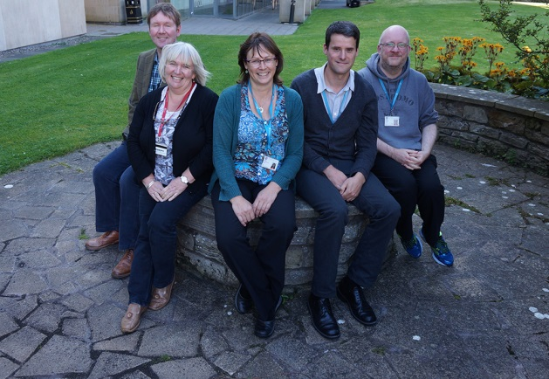
The Open Access and Research Publications Support Team
2 posts funded from RCUK grant
Active programme of advocacy and support

Slide 14
Open Access Team (Library
Researcher
Researcher
Researcher
Researcher
Researcher
Researcher

Slide 15
Lean
Process refinement covered funder mandates, APC processes and extended to cover HEFCE policy
Energised us. Gave focus. And list of 150+ actions with timeline for real signs of engagement and uptake by April 2015
Communications strategy for open access
Simple message approach
New web pages
Clear points of contact
Use 2014 and 2015 as a learning experience and build up to the real onset of compliance in April 2016

Slide 16
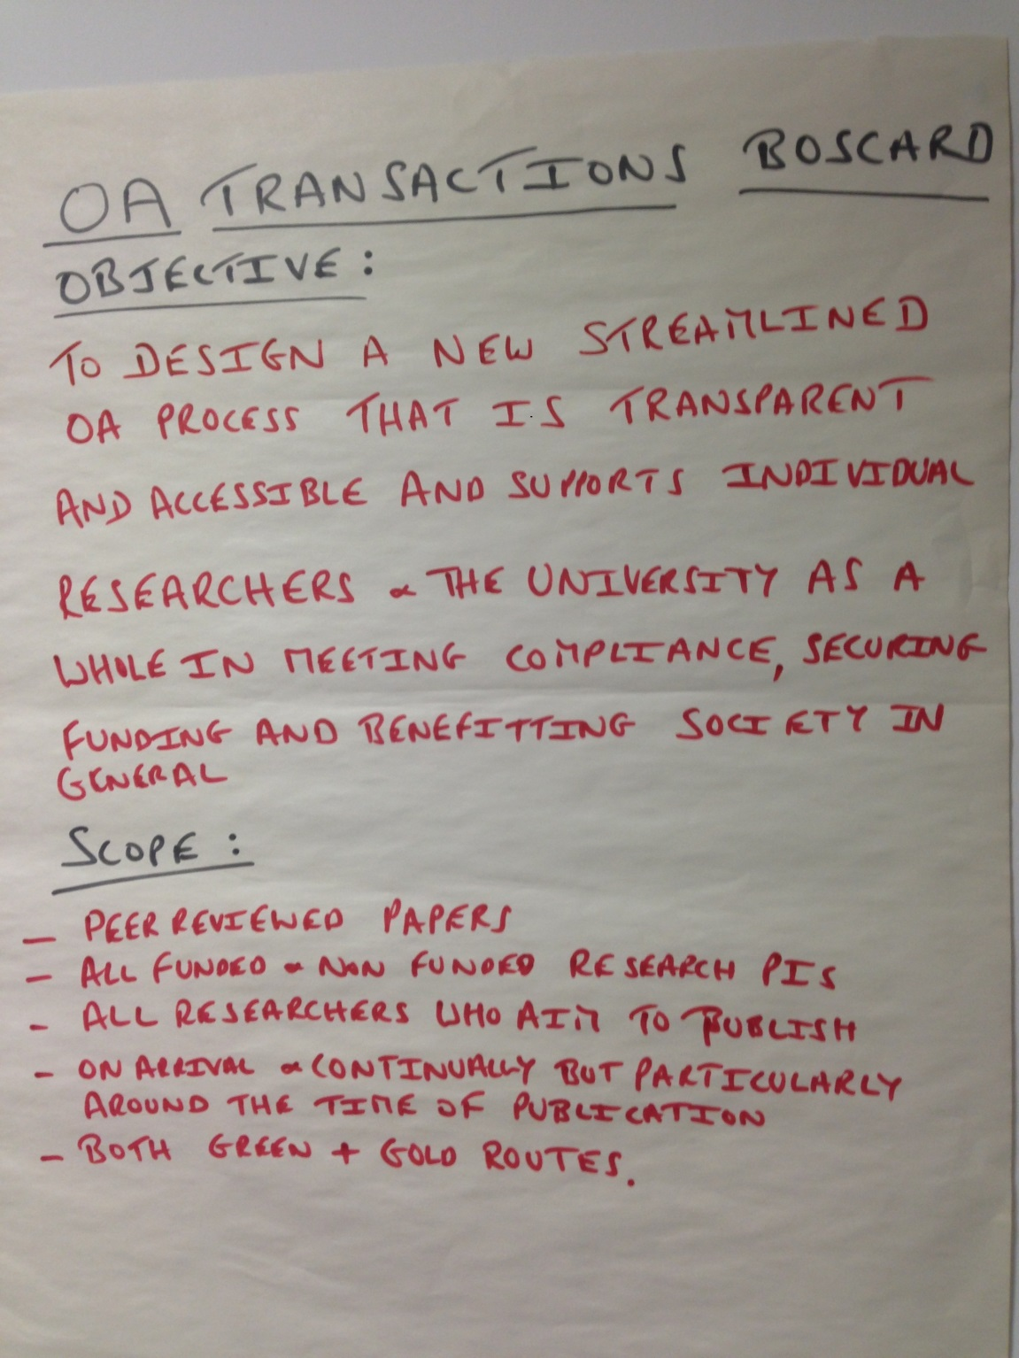
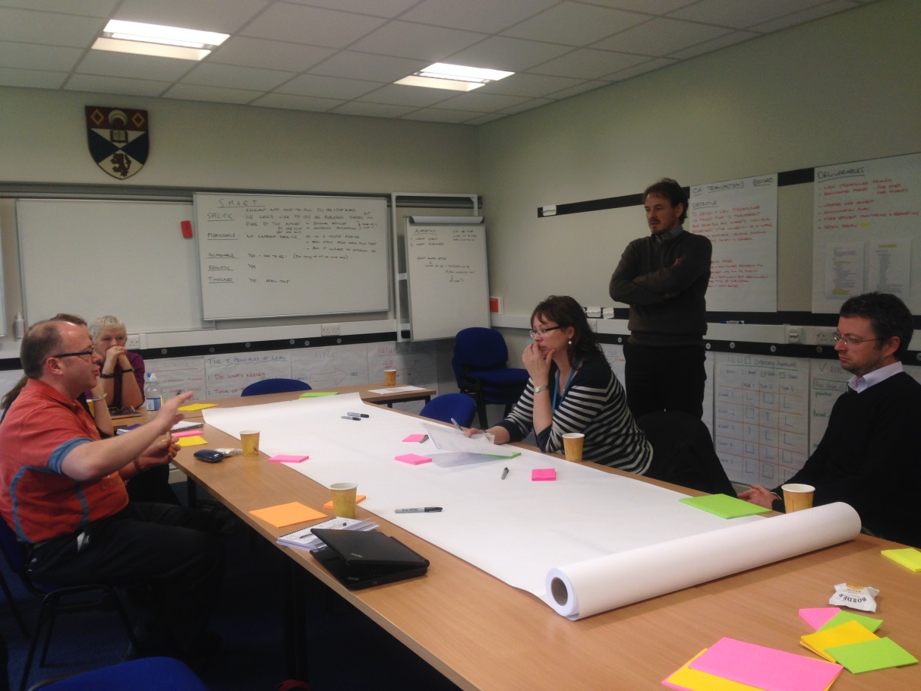

Slide 17
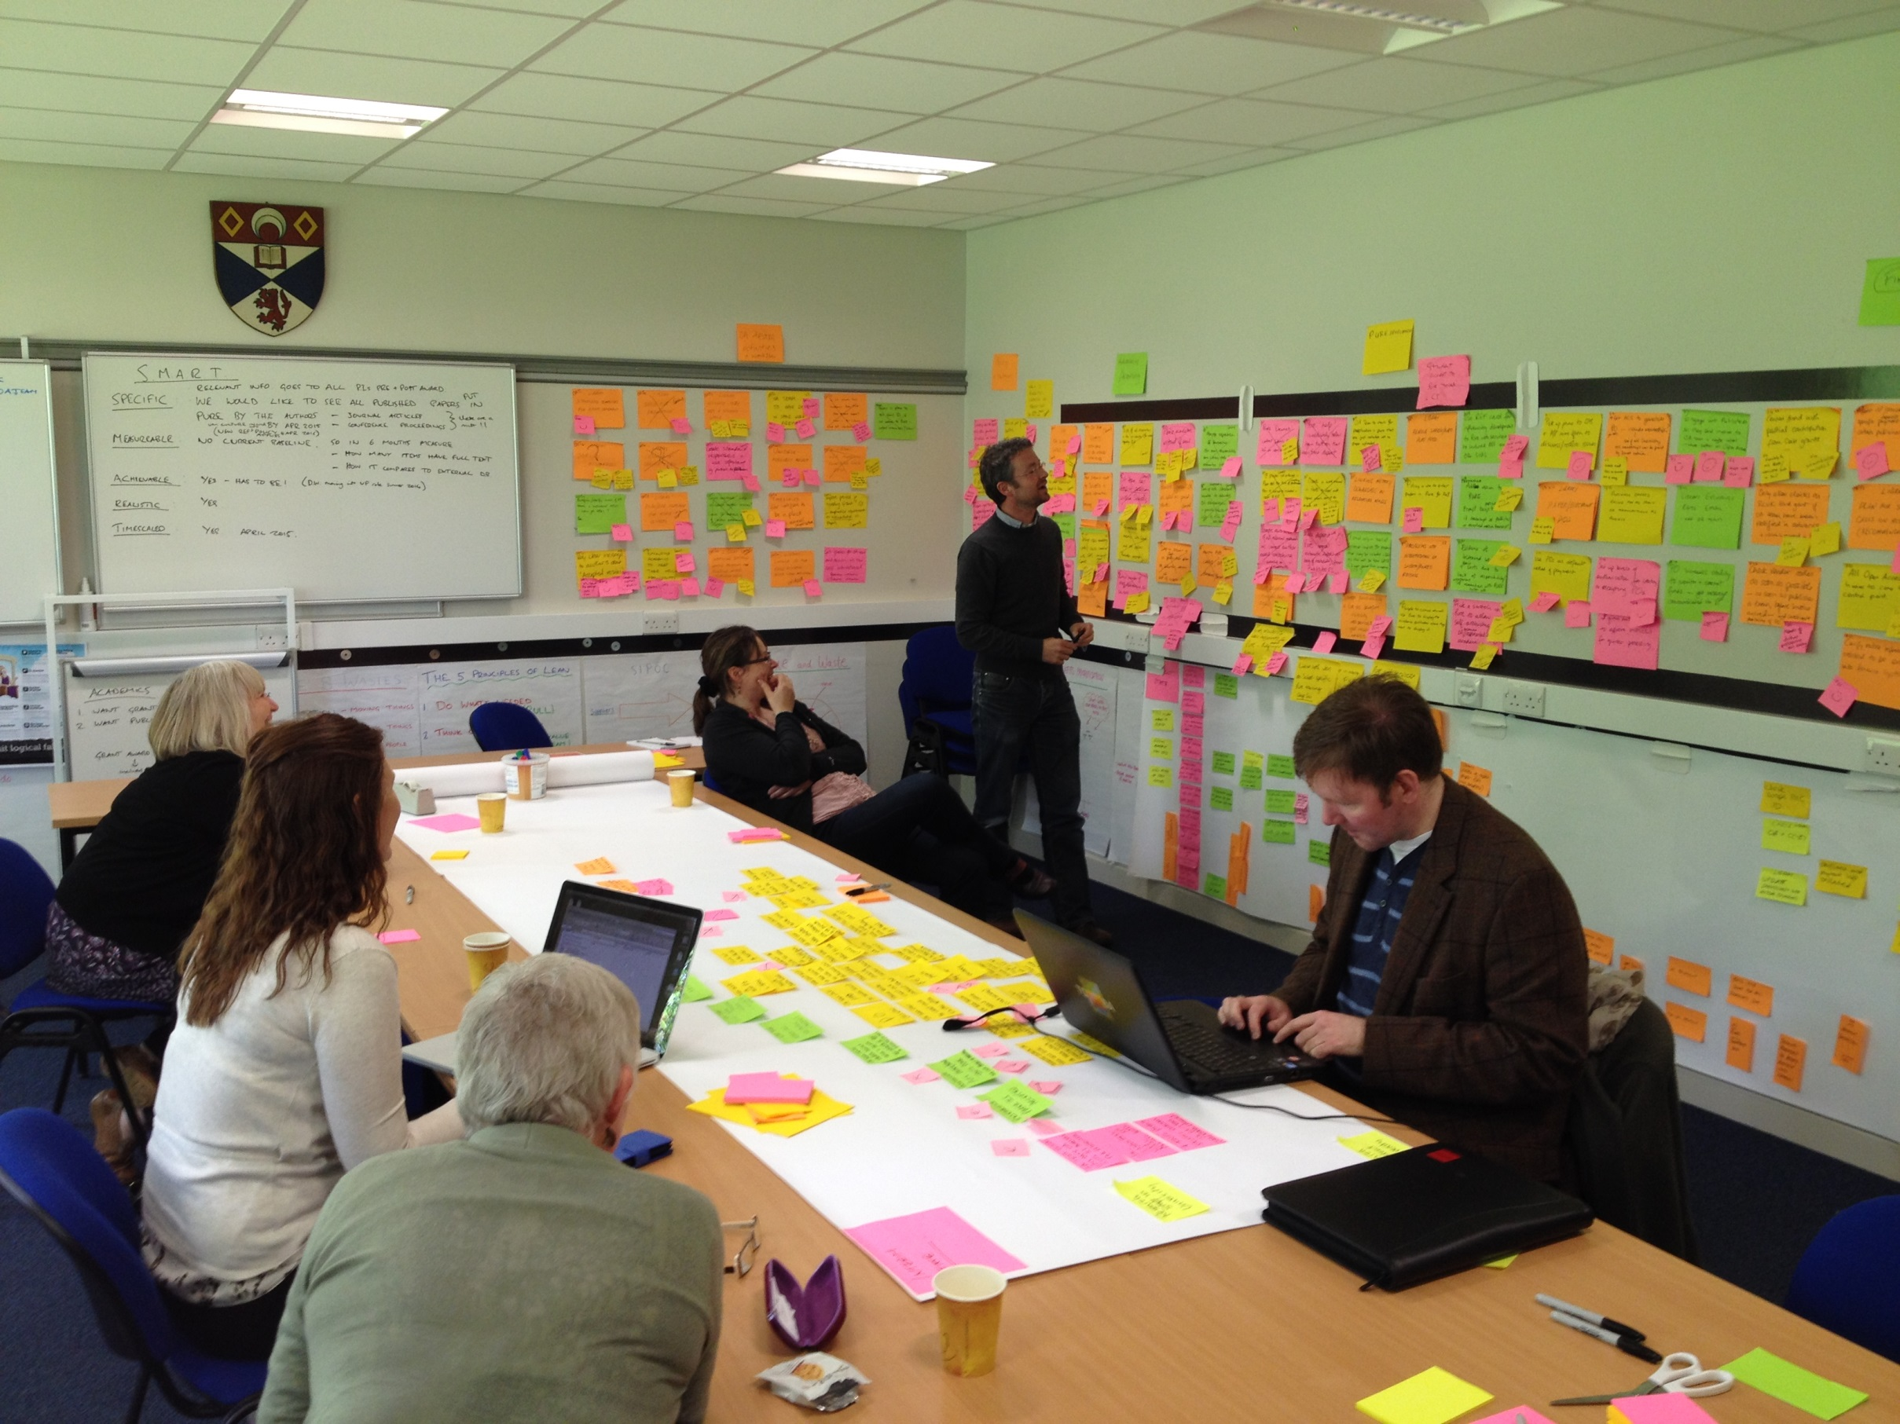

Slide 18
Pathfinder projects
Joint LOCH project with Edinburgh and Heriot Watt
http://libraryblogs.is.ed.ac.uk/loch/2014/06/24/welcome-to-the-loch-blog/
http://openaccess.jiscinvolve.org/wp/pathfinder-projects/
Community of practice and best practice
System and workflow elements
Human elements
Fits in well with our Lean outcomes and actions for communication and support for authors
Mini pathfinder pilot projects with minimum of 3 academic schools to lead on best practice and efficiencies

Slide 19
Which key stakeholders will you engage with to make open access compliance happen?
What key tools and tactics can be used to develop compliance for the Hefce REF policy?
How do we get to know about newly accepted publications so that the support, dialogue and compliance workflow can begin?
How will you resource your compliance work? Will it be centralised or distributed? Will it be mediated centrally or chiefly done by the author/researcher?

Slide 20
Mini pathfinders
Get initial meeting with Head of School, Director of Research and/or key School managers or administrative staff
Have a set of questions and discussion points ready. Ask how they think they can achieve compliance
Seed ideas re. partnerships and joint processes
Listen!

Slide 21
Types of questions, partnership ideas and scoping
How deliver simple messages, best communication paths and tactics?
How best achieve dialogue with authors?
Focus groups?
How do we get authors working together and supporting each other rather than being isolated
Who are the key School contacts?
Action plans?
Blend together funder compliance and Hefce policy compliance
How do we work together?
You deposit, we do the rest
How do we measure effectiveness?

Slide 22
Chemistry
High volume of publications
Large number of staff
Lot of RCUK funding, plus publisher schemes in place for gold eg RSC vouchers, ACS membership
New HOS and very engaged with getting processes in place
Start of new distributed model. School office and admin staff become a hub for the deposit of publications when they are accepted for publication and do deposit into Pure
Key activity based on specific research groups and admin staff
Library and RPO teams do training and support
Benchmarking on progress to be done by regular compliance reports from Pure
Goal = 100% of publications meeting Hefce policy compliance

Slide 23
Article accepted by publisher
Author receives notification
(Library may receive notification)
Author notifies School office
Forward notification email
Send accepted manuscript
School office enters article in PURE
Create new metadata record
Upload full text accepted manuscript
Library validation
Library enhances metadata
Library checks version, applies embargoes
Follow-up and advice
Library contacts authors/office for additional information and/or correct versions
Additional actions
Library advises authors on additional funder requirements
Library advises on funding for immediate OA

Slide 24
Computer Science
Existing culture of open access
Used to disciplinary based subject repositories, not institutional systems
Useful to investigate the issues surrounding Conference publications and how to deal with these for REF 2020
Very proactive School administrator (who organises all the funding for Conference attendance)
Pure publications will be the gold source of information to inform staff review
Proposal to put PG joint authors of publications at the forefront of active deposit (stalled)
Start of new distributed model. School office and admin staff become a hub for the deposit of publications when they are accepted for publication and do deposit into Pure
Key activity based on specific research groups and admin staff

Slide 25
Psychology
As yet no engagement in a centralised way at School level
Good individual engagement
Return to them and describe optional models
History
Voluntary engagement and requested presentation and support
Appointed an academic member of staff as an Open Access Compliance Officer
Wrote their own guidance for Hefce compliance and funder compliance which we then fine tuned (value of researcher language)
Fewer publications
Experience of dealing with exceptions

Slide 26
Outcomes so far
New webpages
Screencast for PURE deposit (Screen cast of basic deposit process and time it. To demonstrate that some of this can be done quickly and without too much pain)
Ref monitoring email templates
Ref monitoring workflow doc. Includes monitoring specific schools allocated to members of the central team and using filters in Pure
RCUK and funder compliance checklist eg for RCUK block grant ie RCUK criteria and checks which happen alongside the Hefce checks as required
PURE full text workflow ie validation checks with elements for Hefce policy included. Validation and quality control all done centrally
Minimum metadata set

Slide 27
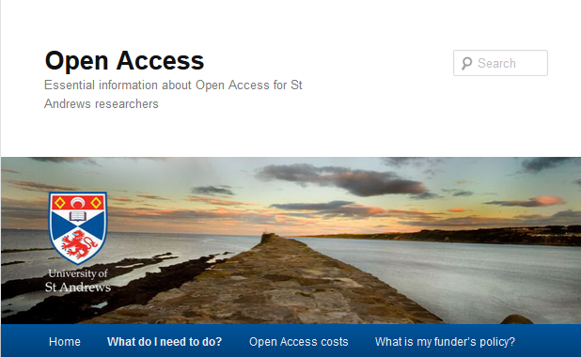
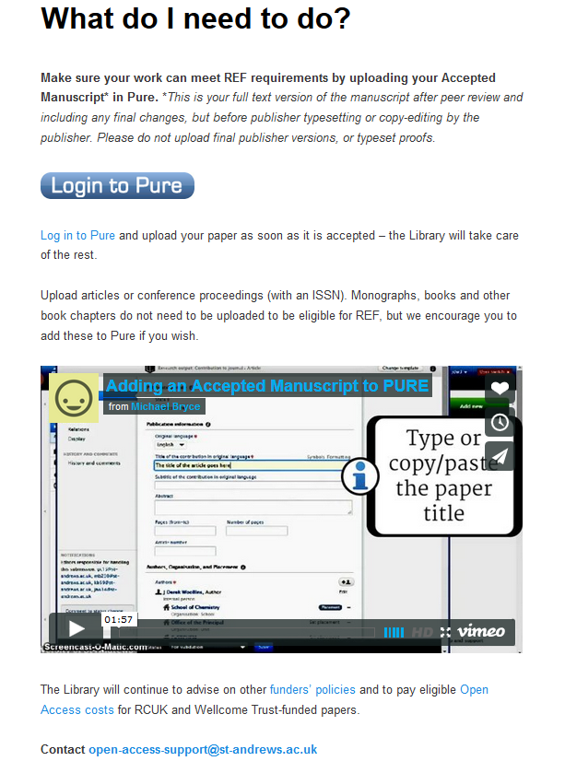
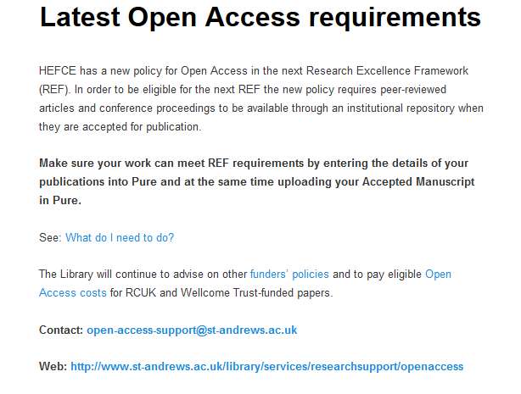
http://openaccess.wp.st-andrews.ac.uk/

Slide 28
REF Monitoring Email Templates
Main template
Specifics
1. If there is an accepted manuscript, and the accepted date is not known
2. If there is an accepted manuscript, and it was deposited after 3 months
3. If there is an accepted manuscript, and it was deposited within 3 months
4. If the wrong article type is uploaded
5. If there is no accepted manuscript, and the accepted date is not known
6. If there is no accepted manuscript, and the 3 month window has lapsed
7. If there is no accepted manuscript, and the 3 month window is still open

Slide 29
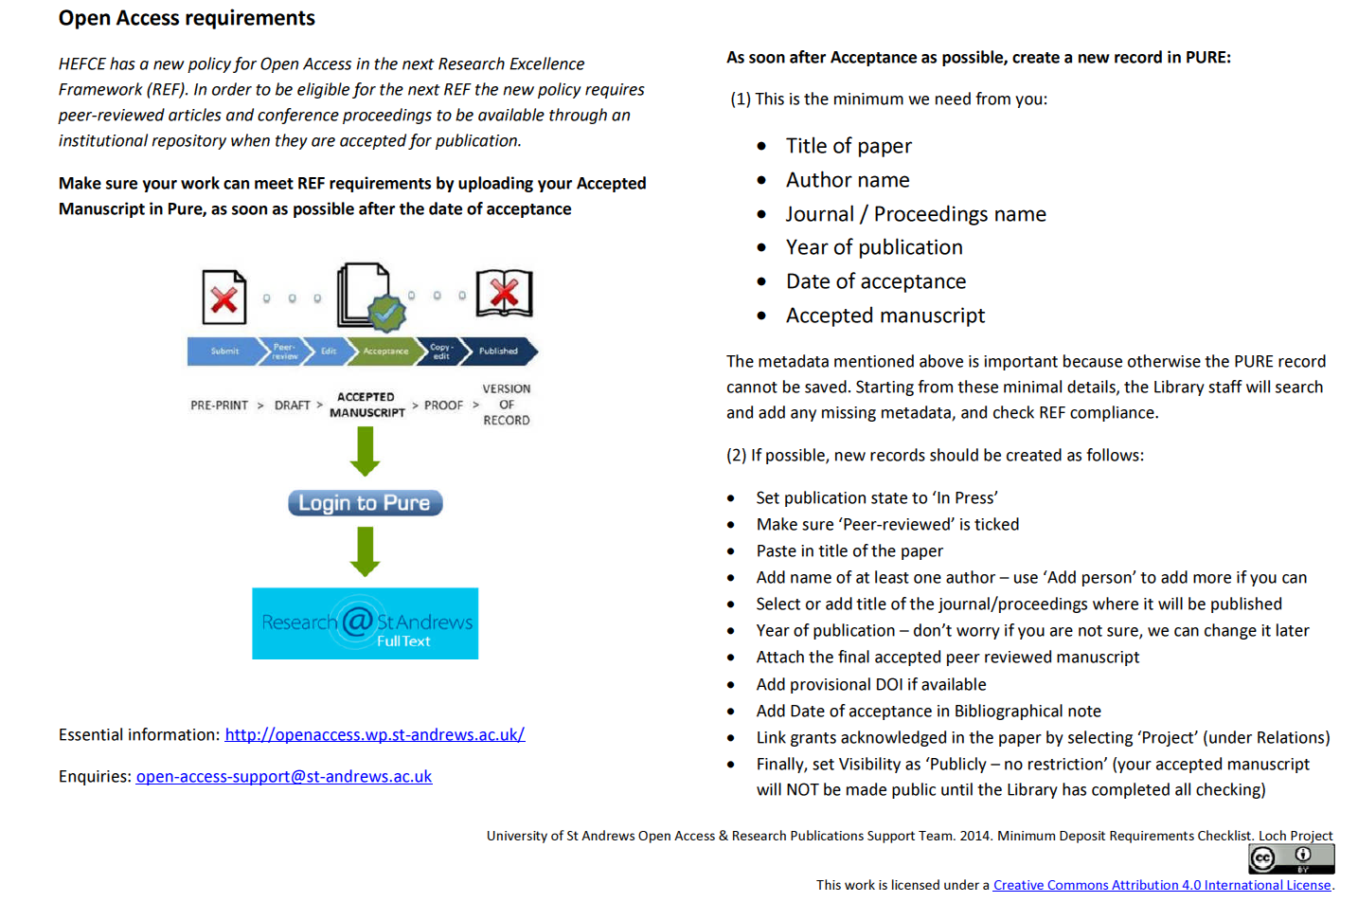

Slide 30
In addition…..
Monthly newsletters about open access issues
Active blog which drives traffic to repository and help pages
Contact lists for Admin contacts/School managers as well as HOS and DOR. Hit list of Schools for training sessions
Centralised training sessions. Short drop ins.
Repetition of compliance messages
OASG agenda. Try out CIAO
Content statistics
Enquiry stats/OARPS team activities to project staffing and resourcing needs

Slide 31
Results
Returning customers
Requests for training sessions
Increase in enquiries
Upskilling in fine detail of Hefce policy. Resolving queries
Contact with School administrators and PAs
Learning what motivates authors to buy in to the OA process
Understanding disciplinary needs and approaches
Reporting good stats on usage
Increase in content and compliance

Slide 32
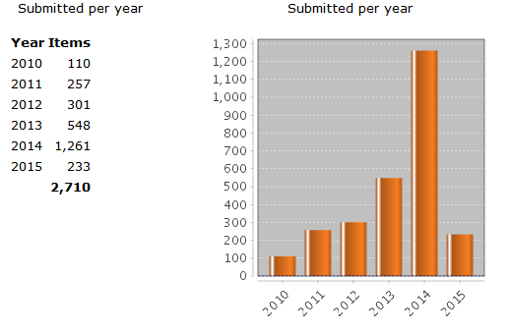
Repository research collection full text growth stats

Slide 33
Researcher (Open access is just one of the things I do)
Open Access Team (Library)
Research Policy Office
Open Access Team (Library)
Research Group Hub
Open Access Team (Library)
School Hub
Open Access Team (Library)
Open Access Team (Library)
School administrator

Slide 34
Open access new research pages
http://openaccess.wp.st-andrews.ac.uk/
Library web pages
http://www.st-andrews.ac.uk/library/services/researchsupport/openaccess/
Open Access blog: http://univstandrews-oaresearch.blogspot.co.uk/
Journal hosting service:
http://www.st-andrews.ac.uk/library/services/researchsupport/journalhosting/
LibGuide: http://libguides.st-andrews.ac.uk/openaccess
Email: open-access-support@st-andrews.ac.uk

